Slide 1




Easter Hunt with LibreOffice
Software Freedom Day 2025
Suraj Bhattarai
Liaison, LibreOffice Community
Modified LibreOffice Presentation Template (Community)
1
Notes:
Okay, this seems clear to me!
Ready everyone??
I don't hear you aloud, can you repeat it once again?
opps! I seem to forget that I am recording this talk all alone.
Whatsoever, I can always speak upto you about some open source and community topics!
Lets's go!!!

Slide 2


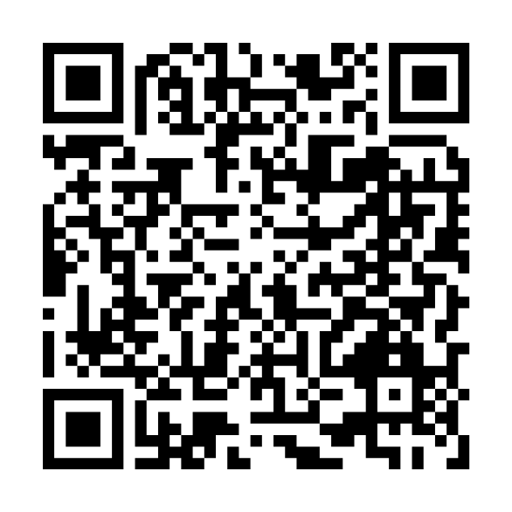

About Me
> Member, The Document Foundation (TDF)
> Member, Open Source Initiative (OSI)
> Cloud Native Engineer
What I do?
Advocate for the LibreOffice project
& Open Source in general
.……..
Modified LibreOffice Presentation Template (Community)
2
Notes:
Before I start talking about Diversity, Inclusion, and Community Model in Free Software Communities,
let's hear it once again!
Apart from being a Liaison and Serving LibreOffice Community, even before, I used to advocate for open source softwares and talk in some penguin like sounds.
okay jokes apart! Our favorite Tux speaks British English! Looks like some folks caught him up from the British coastlines.
Kushal: But suraj, I don't remember penguins in the United Kingdom, I thought they are habitat to just the South Pole.
Suraj: Well, Kushal, I keep this up to you to find out! Good luck!
In the meanwhile, I am back to my talk!
Also, I am a Computer Science educator, and I teach CS50 in Nepal, I overlook partnership and public relations as an Outreach expert in AskBuddie online community, I guess you guys know it quite well.
And the list continues…. with more affiliations adding up, let's keep them coming till our second talk.

Slide 3
Software Freedom
Why Open formats matter for software freedom?
Free Software grants four freedoms: copy/distribute, use, study, and modify.
Software freedom ensures users control their tools and data
Open Formats are a key enabler for WYWIWYG software.
Document Freedom is based on Open Formats, such as ODF or Open Document Format, the ISO standard native file format of LibreOffice and other FOSS office suites.
Modified LibreOffice Presentation Template (Community)
3
Notes:
Let's finally talk about communities. Like you have been involved with various student communities, I came up from the ground on-campus society at my university.
I served 3 years there, where the last year I was the president. The society was a registered non-profit, and we were freely enjoying some non-profit benefits we could claim both locally and internationally.
Leading and coordinating the students at my campus, I on the longer run wanted to feel the grasp of real community engagement. And guess what?
it turned out to be LibreOffice for me. I could see new liaisons joining in from diverse background, different phases in life and levels, but all working with one sense in mind, i.e., to grow beyond on-campus communities for the greater good.

Slide 4
Software Freedom
Why is an Open Format?
A file format is the coded structure used to store text, images, video, etc.
Open Formats are based on open standards: public, freely usable, maintained by an open decision-making process.
They are essential to Software Freedom because they let Free Software and users interoperate without barriers.
Modified LibreOffice Presentation Template (Community)
4
Notes:
Let's finally talk about communities. Like you have been involved with various student communities, I came up from the ground on-campus society at my university.
I served 3 years there, where the last year I was the president. The society was a registered non-profit, and we were freely enjoying some non-profit benefits we could claim both locally and internationally.
Leading and coordinating the students at my campus, I on the longer run wanted to feel the grasp of real community engagement. And guess what?
it turned out to be LibreOffice for me. I could see new liaisons joining in from diverse background, different phases in life and levels, but all working with one sense in mind, i.e., to grow beyond on-campus communities for the greater good.

Slide 5
Software Freedom
Why interoperability matters for Software Freedom?
Interoperability lets software communicate and perform read/write operations across programs
Enables collaboration in education, civic tech, and community projects.
Lets developers build, extend, and audit tools across platforms, strengthening freedom and security.
Modified LibreOffice Presentation Template (Community)
5
Notes:
Let's finally talk about communities. Like you have been involved with various student communities, I came up from the ground on-campus society at my university.
I served 3 years there, where the last year I was the president. The society was a registered non-profit, and we were freely enjoying some non-profit benefits we could claim both locally and internationally.
Leading and coordinating the students at my campus, I on the longer run wanted to feel the grasp of real community engagement. And guess what?
it turned out to be LibreOffice for me. I could see new liaisons joining in from diverse background, different phases in life and levels, but all working with one sense in mind, i.e., to grow beyond on-campus communities for the greater good.

Slide 6
Software Freedom
Closed vs Open Formats (Software Freedom Impact)
Closed formats: design info withheld or ignored → no interoperability, prevents study and modification, enables vendor lock-in.
Open Formats: openly specified → enable interoperability, preserve ownership and long-term access, and support independent implementation.
Modified LibreOffice Presentation Template (Community)
6
Notes:
Let's finally talk about communities. Like you have been involved with various student communities, I came up from the ground on-campus society at my university.
I served 3 years there, where the last year I was the president. The society was a registered non-profit, and we were freely enjoying some non-profit benefits we could claim both locally and internationally.
Leading and coordinating the students at my campus, I on the longer run wanted to feel the grasp of real community engagement. And guess what?
it turned out to be LibreOffice for me. I could see new liaisons joining in from diverse background, different phases in life and levels, but all working with one sense in mind, i.e., to grow beyond on-campus communities for the greater good.

Slide 7
Software Freedom
Benefits of Free Software and the community
Documents are readable and writable by anyone; supports contribution and reuse.
Long-term readability as formats evolve without disruption.
Transparency improves security and sustainability for FLOSS projects.
Freely usable by many programs → wider adoption and easier development
Adopting Open Formats is a concrete step toward the four freedoms in real workflows.
Modified LibreOffice Presentation Template (Community)
7
Notes:
Let's finally talk about communities. Like you have been involved with various student communities, I came up from the ground on-campus society at my university.
I served 3 years there, where the last year I was the president. The society was a registered non-profit, and we were freely enjoying some non-profit benefits we could claim both locally and internationally.
Leading and coordinating the students at my campus, I on the longer run wanted to feel the grasp of real community engagement. And guess what?
it turned out to be LibreOffice for me. I could see new liaisons joining in from diverse background, different phases in life and levels, but all working with one sense in mind, i.e., to grow beyond on-campus communities for the greater good.

Slide 8

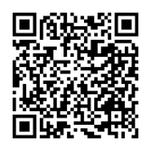

libreoffice.org/community/get-involved
libreoffice.org/community/get-involved
libreoffice.org/community/get-involved
Get involved Today!
whatcanidoforlibreoffice.org
… web: bhattaraisuraj.com.np (New version under Construction)
… email: suraj@libreoffice.com
All text and image content in this document is licensed under the Creative Commons Attribution-Share Alike 3.0 License (unless otherwise specified). "LibreOffice" and "The Document Foundation" are registered trademarks. Their respective logos and icons are subject to international copyright laws. The use of these therefore is subject to the trademark policy.
Modified LibreOffice Presentation Template (Community)
8

Slide 9
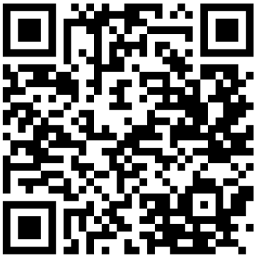

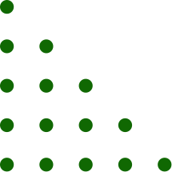
Time for Easter Hunt fun
Visit libreoffice.asia/eastergames/en/
Collect LibreOffice Stickers from Neerajan Vai
READY?
Modified LibreOffice Presentation Template (Community)
18
Notes:
Now, about building communities, before anything, we need to understand where do people come from, what are their motives, how closely they share the common vision for growth, what do they enjoy? and more.
It's always great when the leader helps the new contributor in their every little steps. It's even good if you can work in group with such peoples. And in the process, you communicate and collaborate beyond your boundaries to other similar communities.

